Slide 1
Industrial Economics
PPT – 3
Demand and Supply
Law of Demand, Shifts and Changes in Demand,
Law of Supply, Shifts and Changes in Supply,
Market Equilibrium, Shortage and Surplus, Price Ceiling and Price Floor

Slide 2



A quick recap on last class
Economic problem :
It is the problem of choice, involving satisfaction of unlimited wants out of limited resources having alternative uses.
Scarcity :
Scarcity refers to the limitation of supply in relation to demand for a commodity.
Economics is concerned with selection of resource under conditions of scarcity
Opportunity cost:
It is the cost of next best alternative foregone.

Slide 3
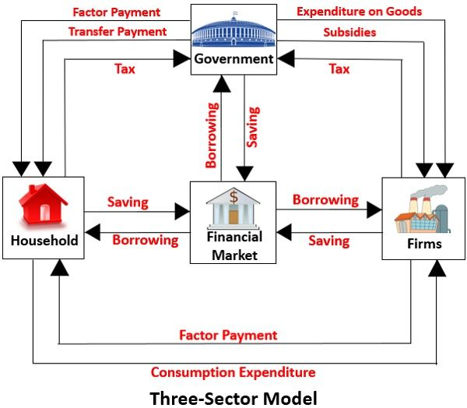
Circular flow of income

Slide 4

The Basics of Supply and Demand
Supply-demand analysis is a fundamental and powerful tool that can be applied to a wide variety of interesting and important problems. To name a few:
Understanding and predicting how changing world economic conditions affect market price and production
Evaluating the impact of government price controls, minimum wages, price supports, and production incentives
Determining how taxes, subsidies, tariffs, and import quotas affect consumers and producers

Slide 5
Definitions
Demand: Total quantity customers are willing and able to purchase.
Demand function: The relationship between the quantity demanded of a particular commodity and the factors influencing it is expressed by the demand function.
D_{x} = f (P_{x,} P_{r}, Y, T, F )
Where D_{x}= Demand for Commodity x, P_{x}= Price of the given Commodity x, P_{r} = Prices of Related Goods, Y = Income of the Consumer, T = Tastes and Preferences, F = Expectation of Change in Price in the future.
Supply function: A behavior function for producers.
Q_{s} = f (P_{s,} W, C, T )
Where Q_{s}= Supply of Commodity s, P_{s}= Price of the given Commodity x, W = wage of labor, C = Cost of raw materials, T = Tax.

Slide 6
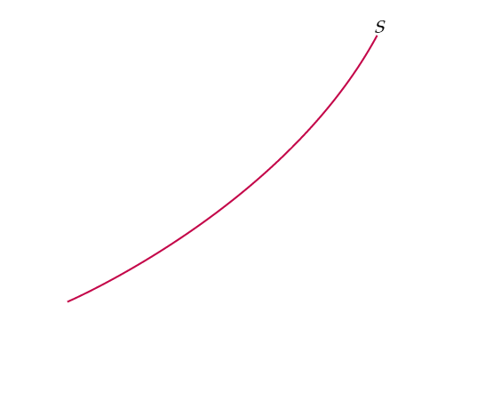
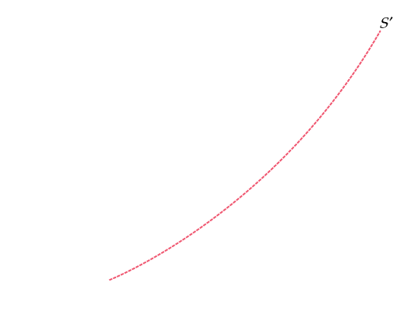

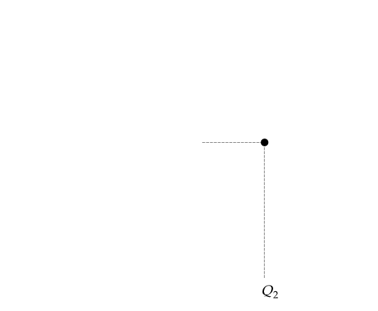
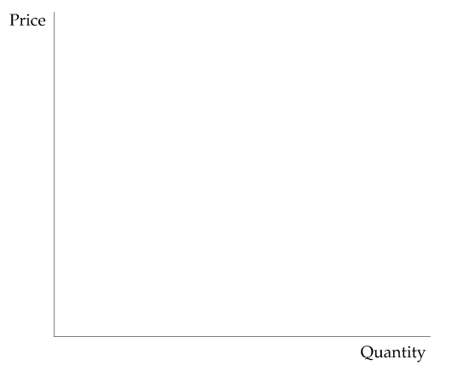
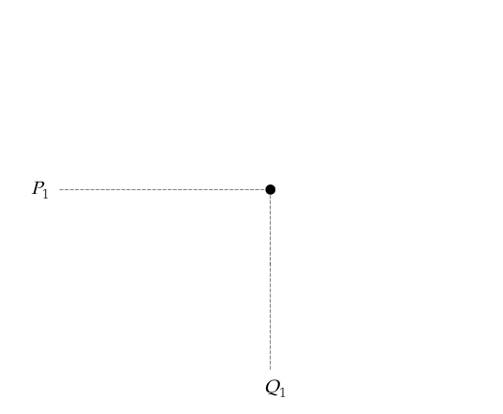
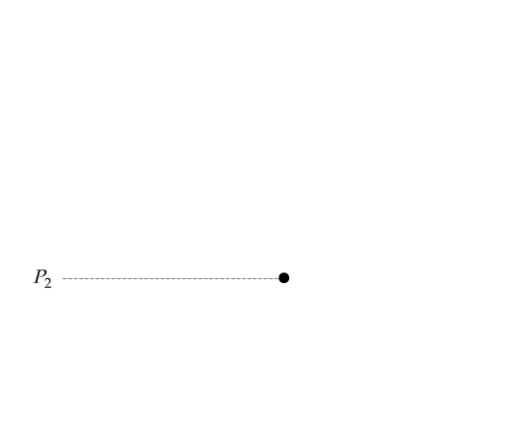
The Supply Curve
● Supply Curve - shows the relationship between the quantity of a good that producers are willing to sell and the price of the good.
Figure 2.1
The Supply Curve
The supply curve, labeled S in the figure, shows how the quantity of a good offered for sale changes as the price of the good changes. The supply curve is upward sloping: The higher the price, the more firms are able and willing to produce and sell.
If production costs fall, firms can produce the same quantity at a lower price or a larger quantity at the same price. The supply curve then shifts to the right (from S to S’).

Slide 7
The Supply Curve
Other Variables That Affect Supply The quantity supplied can depend on other variables besides price. For example:
The quantity that producers are willing to sell depends not only on the price they receive but also on their production costs, including wages, interest charges, and the costs of raw materials.
When production costs decrease, output increases no matter what the market price happens to be. The entire supply curve thus shifts to the right.
Economists often use the phrase change in supply to refer to shifts in the supply curve, while reserving the phrase change in the quantity supplied to apply to movements along the supply curve.

Slide 8
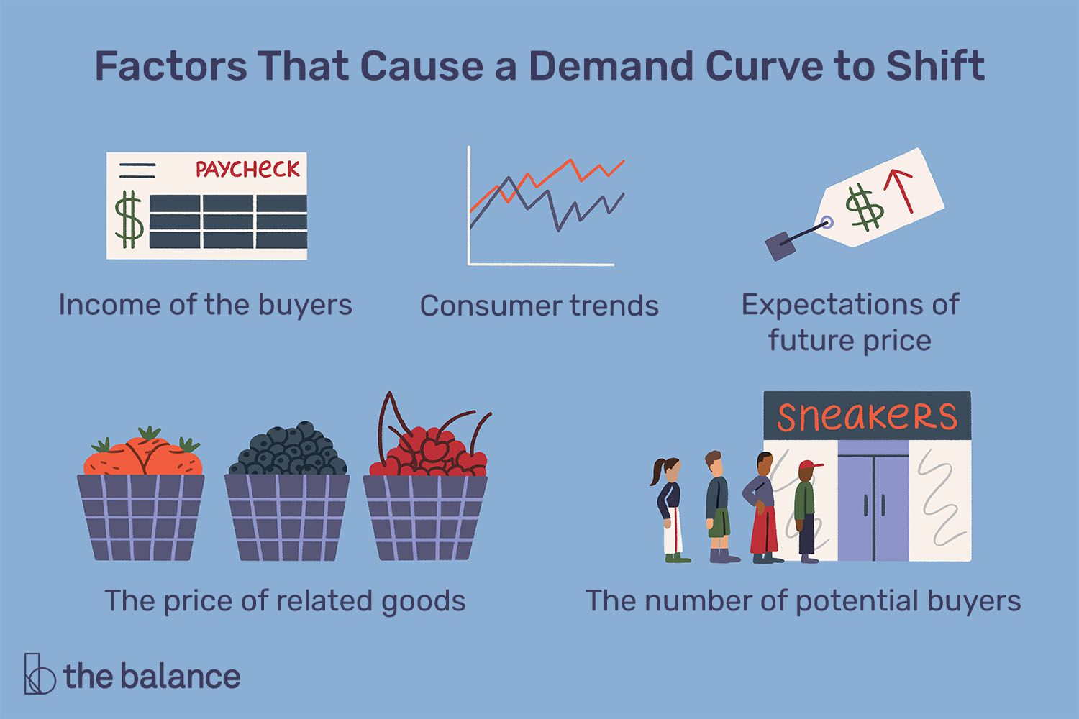

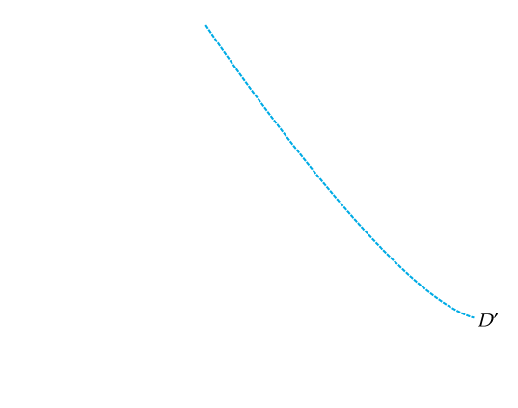
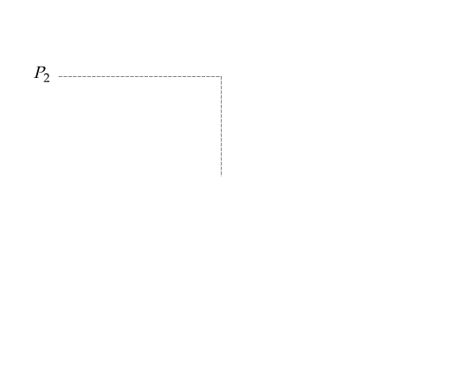
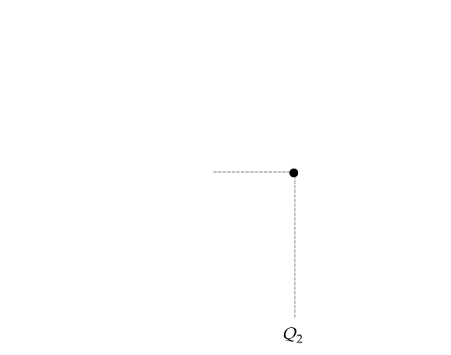
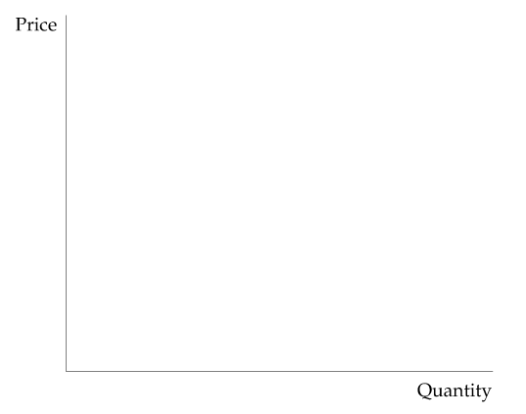
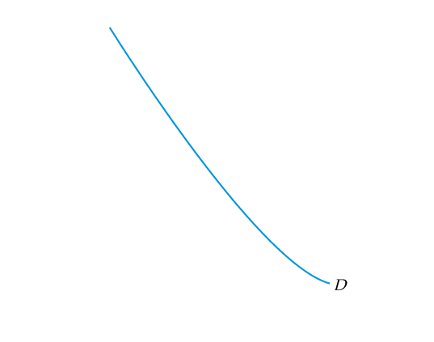
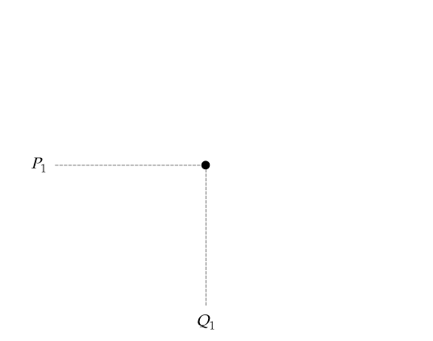
The Demand Curve
● Demand Curve shows the relationship between the quantity of a good that consumers are willing to buy and the price of the good.
Figure 2.2
The Demand Curve
The demand curve, labeled D, shows how the quantity of a good demanded by consumers depends on its price. The demand curve is downward sloping; holding other things equal, consumers will want to purchase more of a good as its price goes down.
The quantity demanded may also depend on other variables, such as income, the weather, and the prices of other goods. For most products, the quantity demanded increases when income rises.
A higher income level shifts the demand curve to the right (from D to D’).

Slide 9
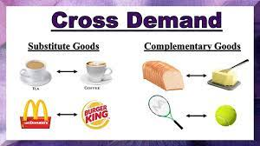





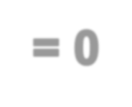






Shifts in Demand
When Price of X Increases,
Quantity Demanded
of Y Decreases
Quantity Demanded of Y Increases
Complements
Two goods for which an increase in the price of one leads to a decrease in the quantity demanded of the other
Substitutes
Two goods for which an increase in the price of one leads to an increase in the quantity demanded of the
other.

Slide 10
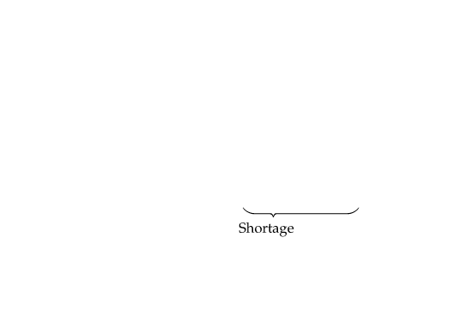
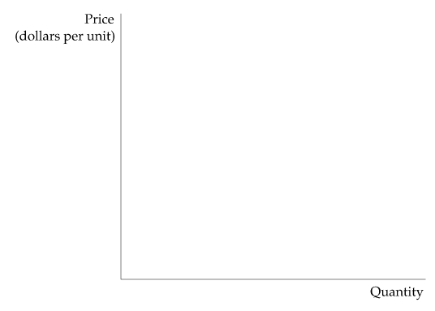
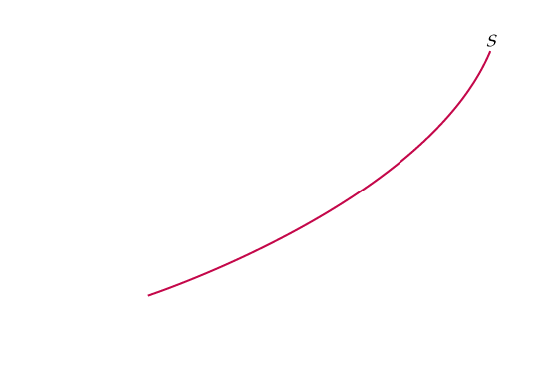
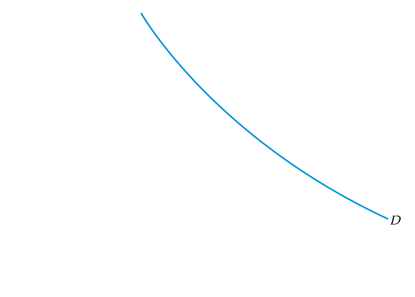
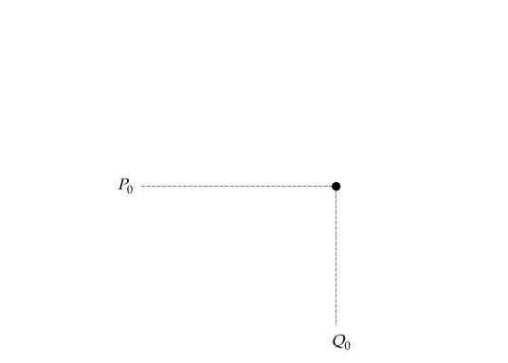
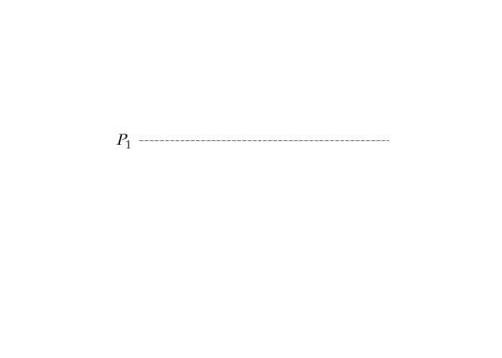
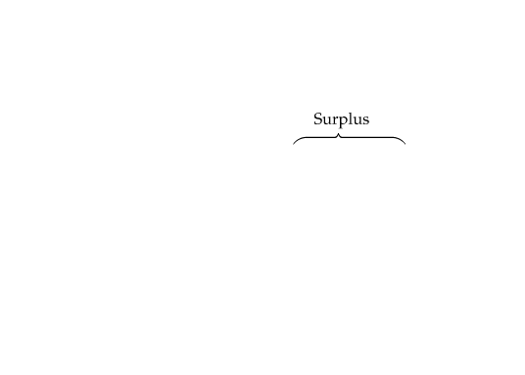
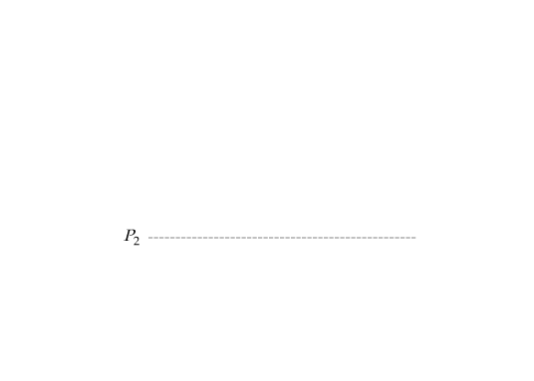
THE MARKET MECHANISM
Figure 2.3
Supply and Demand
The market clears at price P₀ and quantity Q₀ = at the Equilibrium Point
At the higher price P₁, a surplus develops, so price falls.
At the lower price P₂, there is a shortage, so price is bid up.
● surplus Situation in which the quantity supplied exceeds the quantity demanded.
● shortage Situation in which the quantity demanded exceeds the quantity supplied.

Slide 11
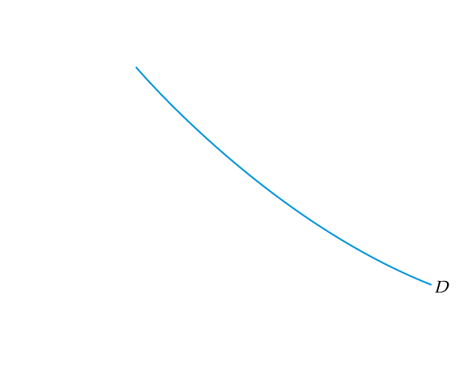

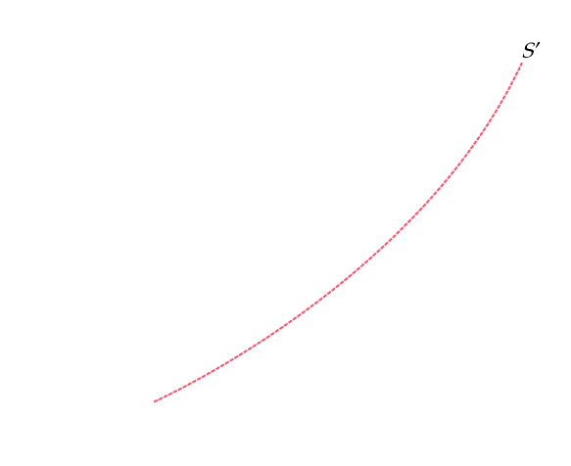
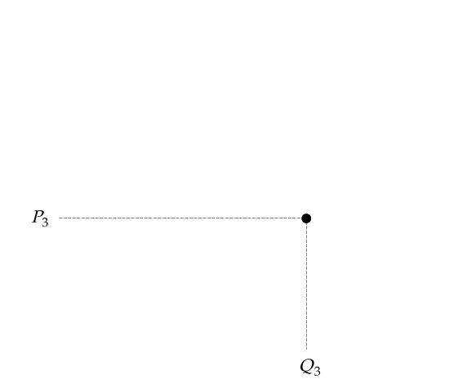
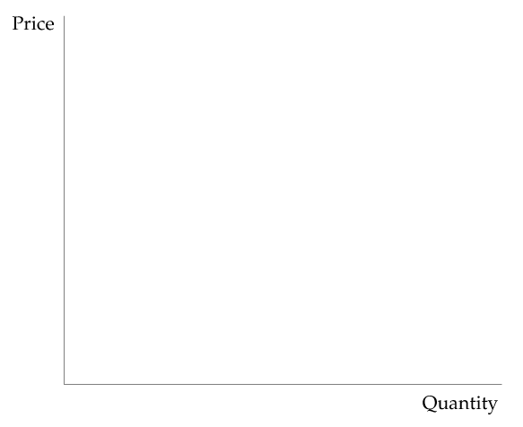
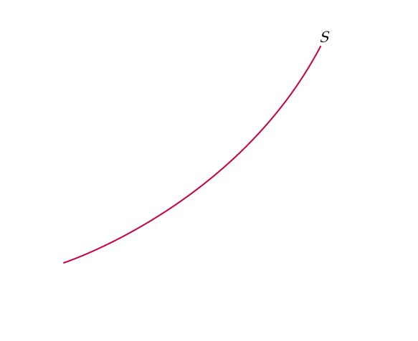
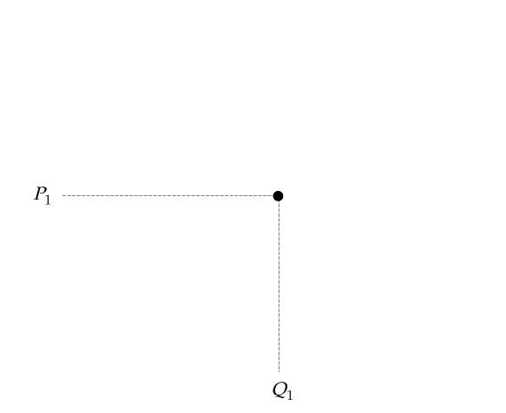
CHANGES IN MARKET EQUILIBRIUM
Figure 2.4
New Equilibrium Following Shift in Supply
When the supply curve shifts to the right, the market clears at a lower price P₃ and a larger quantity Q₃.

Slide 12
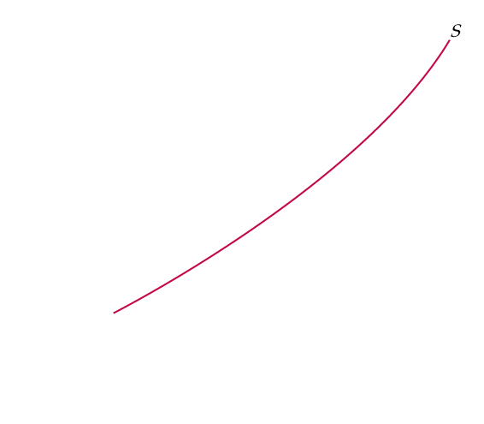
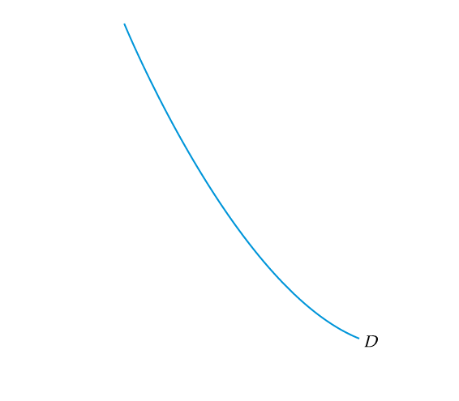
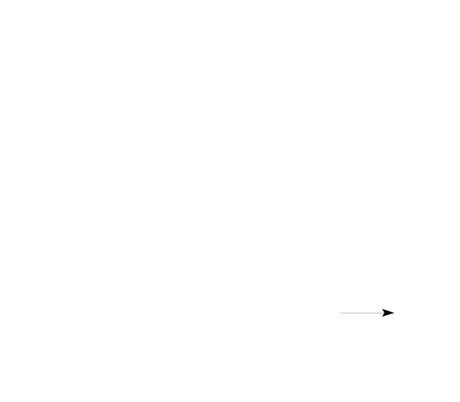
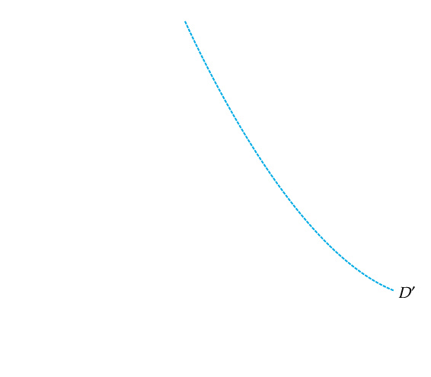
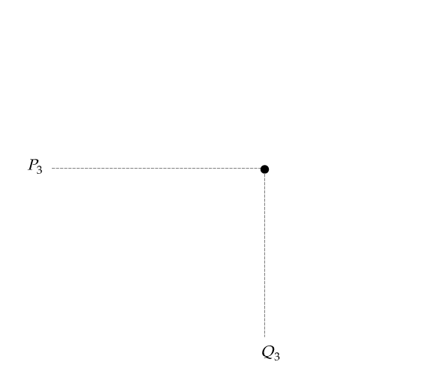
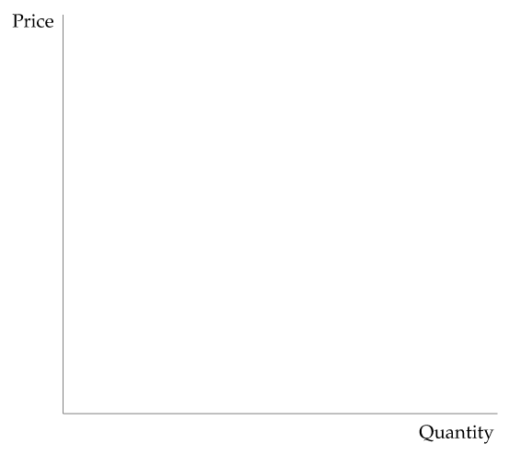
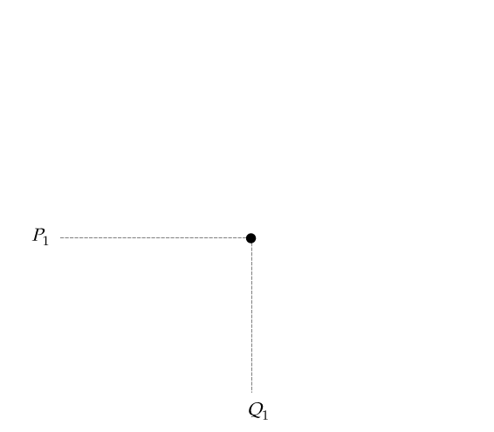
CHANGES IN MARKET EQUILIBRIUM
Figure 2.5
New Equilibrium Following Shift in Demand
When the demand curve shifts to the right,
the market clears at a higher price P₃ and a larger quantity Q₃.

Slide 13
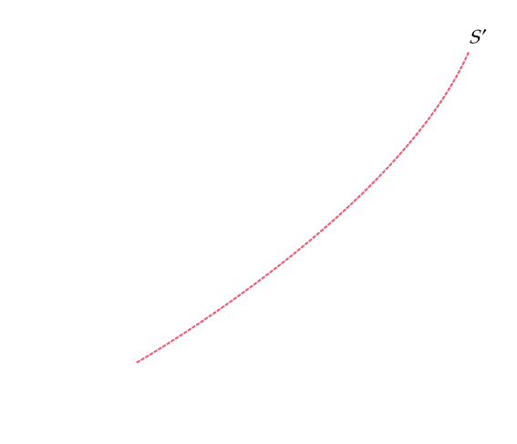
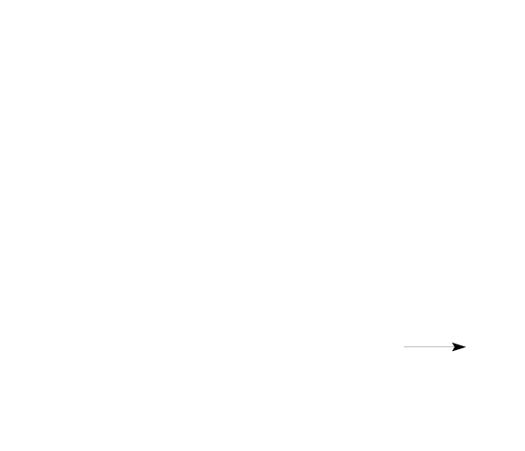
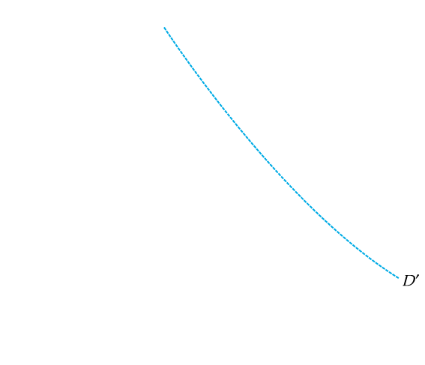
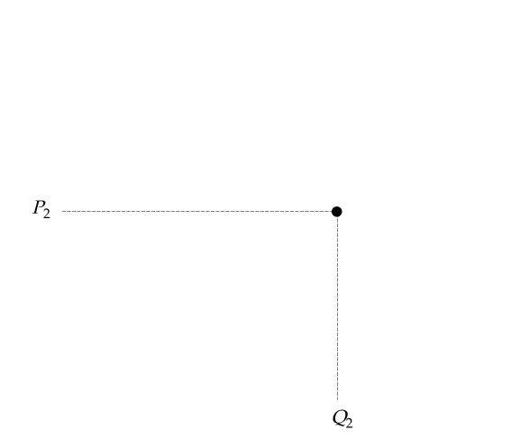
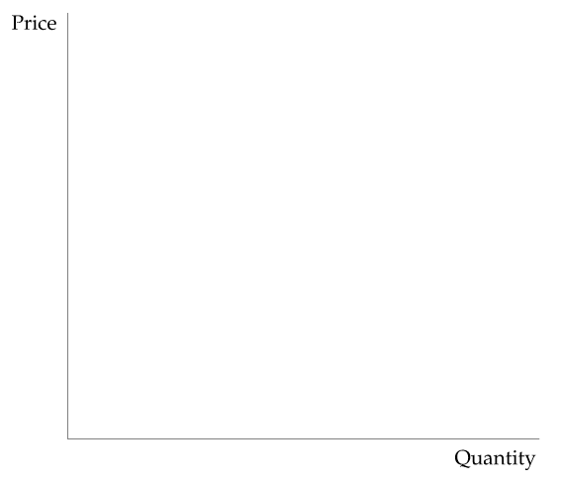
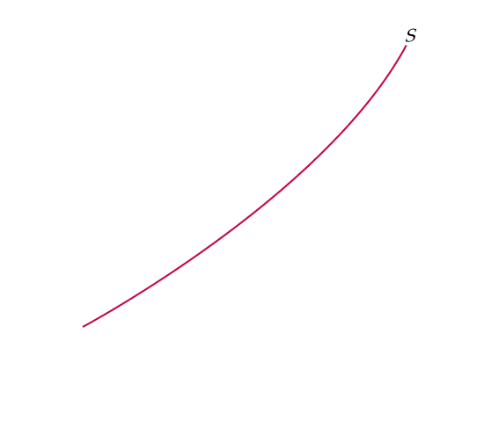
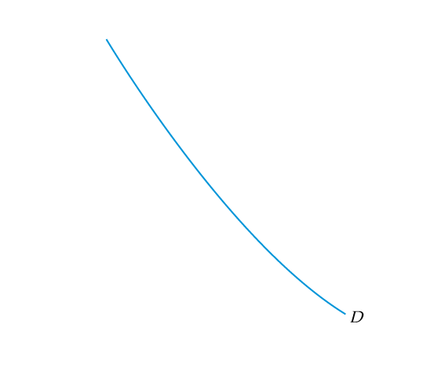
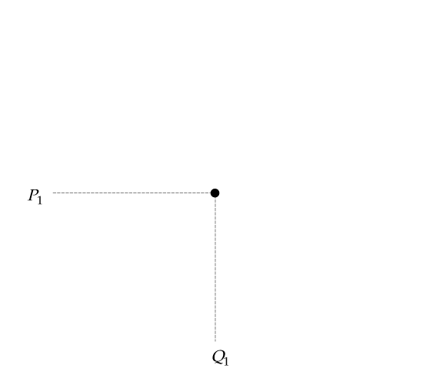

CHANGES IN MARKET EQUILIBRIUM
Figure 2.6
New Equilibrium Following Shifts in Supply and Demand
Supply and demand curves shift over time as market conditions change.
In this example, rightward shifts of the supply and demand curves lead to a slightly higher price and a much larger quantity.
In general, changes in price and quantity depend on the amount by which each curve shifts and the shape of each curve.

Slide 14
CHANGES IN MARKET EQUILIBRIUM
Demand | Supply | Quantity | Price
Increases | Increases | Increases | Ambiguous
Decreases | Decreases | Decreases | Ambiguous
Increases | Decreases | Decreases | Increases
Decreases | Increases | Increases | Decreases

Slide 15
MARKET EQUILIBRIUM, SHORTAGE & SURPLUS
Figure 2.3
Supply and Demand
The market clears at price P₀ and quantity Q₀. The Equilibrium Price is Po & Equilibrium Quantity is Qo
At the higher price P₁, a surplus develops, so price falls.
At the lower price P₂, there is a shortage, so price is bid up.
● surplus Situation in which the quantity supplied exceeds the quantity demanded.
● shortage Situation in which the quantity demanded exceeds the quantity supplied.

Slide 16
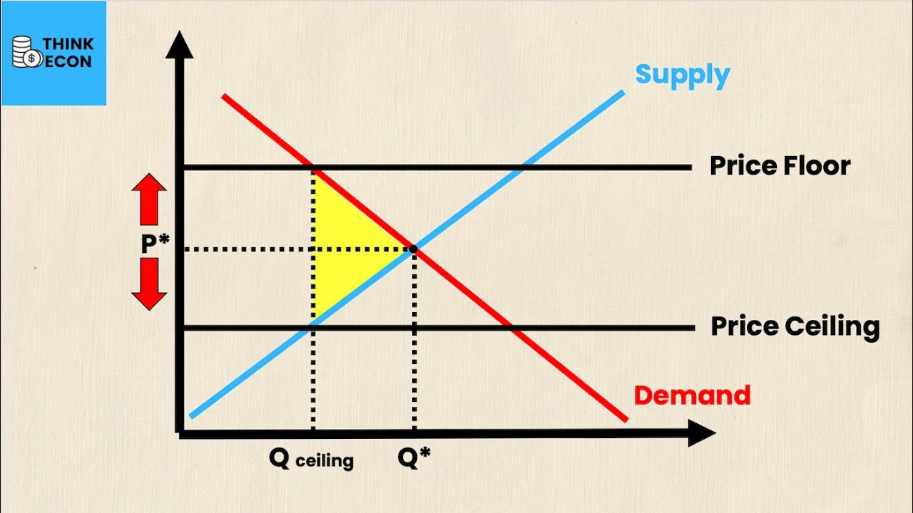
Deviation from market equilibrium
Price Floor: A minimum price set by government or an agency above the equilibrium point.
Examples: minimum wage, MSP for agriculture products.
Price Ceiling: A maximum price set by government or an agency below the equilibrium point.
Examples: Rent rate in cities, Covid-19 vaccines.

Slide 17
Different types of goods
Normal goods
A good that experiences an increase in demand due to an increase in consumers income.
Examples: Clothes, Furniture
Inferior goods
An inferior good is one whose demand drops when people's incomes rise.
Example: second hand clothes
Luxurious goods
They are not deemed essentials or necessities to live. These goods are highly desired and can be purchased when a consumer's income rises.
Examples: cleaning and cooking services, handbags and luggage, certain automobiles
Giffen goods
It is a rare forms of inferior goods that have no ready substitute or alternative.
Examples: bread, rice, and potatoes.
Veblen goods
A Veblen good is an item whose increase in price may actually result in higher sales. These types of goods are often a subset of a luxury good, and this type of good often defies many traditional concepts of economics.
Examples: designer jewellery, fine wines, luxury cars, branded products

Slide 18
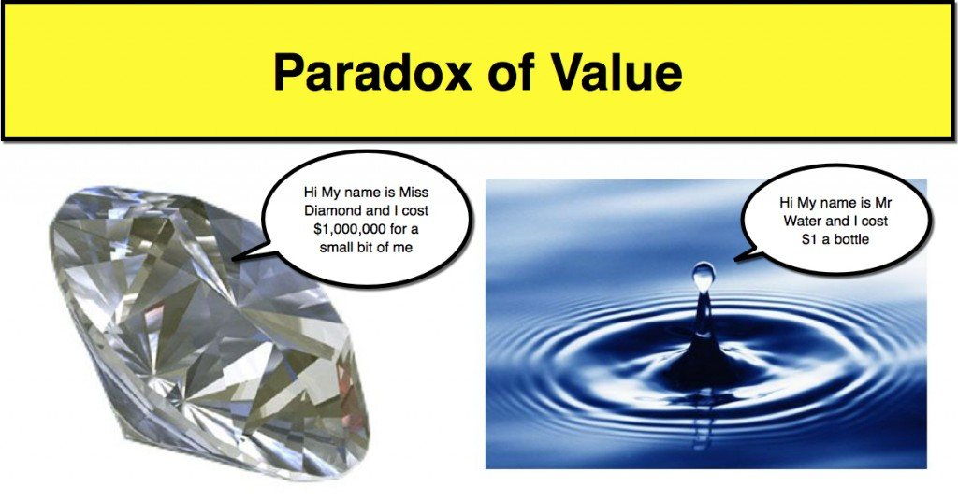
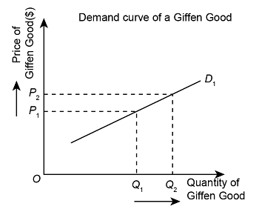
Paradox in Economics
The situation where the variables fail to follow the generally laid principles and assumptions of the economic theory and behave in an opposite fashion.
Giffen paradox
Veblen paradox
Abnormal market behavior where consumers purchase the higher-priced goods whereas similar low-priced (but not identical) substitutes are available.

Slide 19

